Slide 1
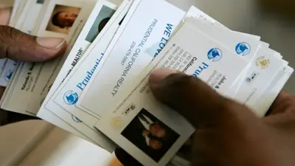
TEXT EXTRACTION AND CLASSIFICATION FROM VISITING CARDS
Flask based python application
BY – AKASH SAYANA
MENTOR – MR. CHANDRADEEP BHATT

Slide 2
INTRODUCTION
Business cards are an essential tool for networking and communication. Business cards often contain crucial contact details such as names, organizations, addresses, contact numbers, and email addresses. Extracting this information automatically can save time and improve efficiency.
Problem: Extracting and organizing information from business cards is time-consuming and prone to errors.
Solution: Our project leverages OCR, image processing, NER, and regex to automate the extraction and classification of relevant details from business card images.
Benefits: Our solution saves time, improves data accuracy, and enhances the efficiency of managing and utilizing business card data.
Objective: Develop a Flask-based Python application that accurately extracts and classifies names, organizations, addresses, contacts, and other essential information from business cards.

Slide 3
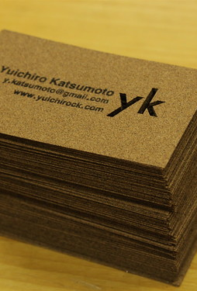
PROJECT OVERVIEW
Project Scope: Our project focuses on developing a text extraction and classification system for business cards.
Methodology: a. Image Processing: We apply advanced image processing techniques to enhance the quality of business card images, enabling better text recognition. b. Optical Character Recognition (OCR): Utilizing OCR algorithms, we extract text from the processed images and convert it into machine-readable format. c. Named Entity Recognition (NER): We employ NER algorithms to identify and categorize specific entities such as names, organizations, addresses, and contacts. d. Regular Expressions (Regex): Regex patterns are used to extract structured data like phone numbers and email addresses.
Expected Outcome: A user-friendly web application that takes business card images as input and returns accurately extracted and classified information.
This Photo by Unknown Author is licensed under CC BY-NC

Slide 4
USE CASES
Contact Management: Easily extract and organize contact information from business cards, allowing for efficient contact management and seamless integration with other platforms or CRMs.
Lead Generation: Extract key details from business cards to identify potential leads and streamline the lead generation process for sales and marketing teams.
CRM Integration: Integrate the extracted business card information with existing Customer Relationship Management (CRM) systems to maintain up-to-date and accurate customer profiles.
Seamless Collaboration: Share extracted business card information with team members, colleagues, or departments, enabling smooth collaboration and improved workflow within an organization.

Slide 5

KEY FEATURES
Accurate Information Extraction: Our system employs advanced OCR and NER techniques to accurately extract information from business card images, ensuring reliable and precise results.
Automated Data Classification: The extracted information is automatically classified into relevant categories, saving time and effort in manual sorting and organization of data.
User-Friendly Interface: Our Flask-based Python application offers a user-friendly interface, allowing users to easily upload business card images, initiate the extraction process, and view the extracted information in a structured format.
Data Validation and Refinement: The extracted information goes through a validation process using regular expressions, ensuring the accuracy and integrity of the extracted data.

Slide 6
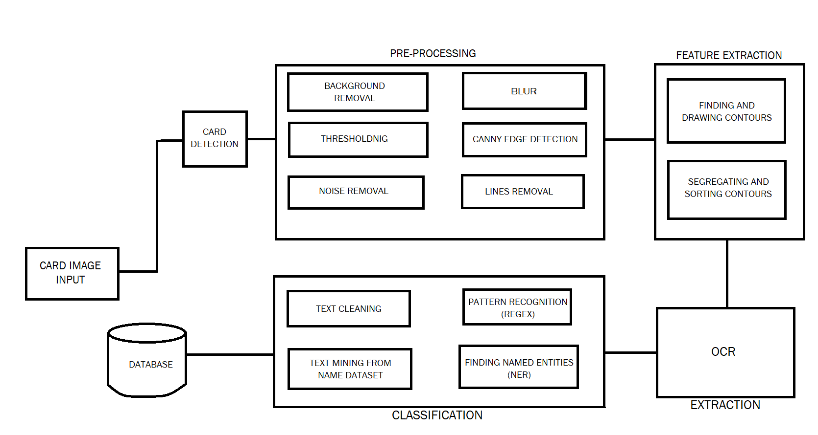
BLOCK DIAGRAM

Slide 7
METHODOLOGY
Data Collection: We gather a diverse dataset of business card images from various sources to ensure comprehensive coverage of different designs, layouts, and text variations.
Preprocessing: The collected images undergo preprocessing techniques such as image enhancement, noise reduction, and normalization to improve the quality and clarity of the images. This step helps optimize the performance of subsequent processing steps.
Optical Character Recognition (OCR): Using state-of-the-art OCR algorithms, we extract text from the preprocessed images. OCR algorithms recognize characters and convert them into machine-readable text, allowing us to extract the textual information present on the business cards.
Named Entity Recognition (NER): To identify and classify relevant information, we employ NER techniques. NER algorithms analyze the extracted text and identify entities such as names, organizations, addresses, contact details, and email addresses. This step enables accurate and structured information extraction.

Slide 8
METHODOLOGY CONTD.
Regular Expressions (Regex)
We utilize Regular Expressions (Regex) to apply specific patterns and rules for extracting specific data fields. This helps ensure the precision and consistency of information extraction, particularly for fields like phone numbers, email addresses, and postal codes.
Information Classification
The extracted information is further classified into relevant categories, allowing for easy organization and retrieval. This step improves the usability of the extracted data for downstream applications such as contact management systems or customer databases.
Flask-based Python Application
We develop a web-based application using the Flask framework in Python. This user-friendly application provides an intuitive interface for users to upload business card images, process them using our methodology, and obtain the extracted and classified information.

Slide 9
OCR
OCR is a critical technology that enables the extraction of text from images, such as business cards. It plays a pivotal role in converting the visual content on business cards into editable and searchable text.
OCR technology uses sophisticated algorithms to recognize and extract text from images. It analyzes the visual characteristics of the text, including fonts, sizes, and layouts, to accurately convert it into digital text.
In our project, OCR serves as the initial step after pre-processing in extracting information from business card images. It processes the image and converts the text content into machine-readable format.
The extracted text is then further processed, classified, and utilized for various purposes, such as contact management and database integration.

Slide 10
NER
Named Entity Recognition (NER) is a subtask of natural language processing that identifies and classifies named entities within text.
NER is crucial in our project as it helps extract specific information, such as names, addresses, and contact details, from the extracted text of business cards.
It enables the automated identification and categorization of important entities, saving time and ensuring accuracy in information extraction.
NER algorithms are trained to recognize and classify different types of entities, such as person names, organizations, addresses, phone numbers, and email addresses.

Slide 11
REGEX
Regular Expressions (Regex) is a powerful tool for pattern matching and text manipulation. It provides a concise and flexible way to define search patterns, allowing for efficient extraction of specific information from text data.
Here, regex is employed to validate and extract specific patterns of information from the extracted text of business cards. It allows us to define rules and patterns for validating phone numbers, emails etc.
Regex patterns are created based on the expected format or structure of the desired information. These patterns are then applied to the extracted text, allowing regex to identify and extract relevant data based on the defined patterns.

Slide 12
PERFORMANCE METRICS
Precision, recall, and F1-score were used to evaluate the system's performance.
The system was tested on five different business card images, the average precision, recall, and F1-score for all fields combined were 0.74, indicating reasonable accuracy in extracting information from business card images.
The system performed well in predicting the website (5/5 correct).
The address prediction had the lowest performance (2/5 correct), indicating the need for improvement in this area.
Accuracy was computed by dividing the total number of correct predictions by the total number of predictions made which was 0.6 or 60%.

Slide 13
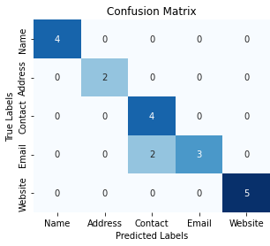
CONFUSION MATRIX

Slide 14
CONCLUSION
The business card text recognition system demonstrated average performance in pre-processing, OCR, pattern recognition, and NER.
Extraction accuracy varied across different fields, with website extraction achieving high accuracy and address extraction needing improvement.
The system achieved an overall average precision, recall, and F1-score of 0.74, indicating reasonable accuracy in extracting information from business card images.
The project successfully developed a flask-based Python application for text extraction and classification from business card images.

Slide 15
FUTURE WORK
Address extraction performance was identified as an area for improvement, potentially due to variations in address formats or font types.
Future work should focus on enhancing address extraction capabilities, such as incorporating additional address recognition techniques or training the system with diverse address data.
Collecting more training data and exploring alternative feature extraction techniques may further enhance the system's performance in extracting information from business cards.
Consider incorporating multi-lingual models to enable classification of names from other languages, expanding the system's language support and usability.

Slide 16
THANK YOU

